Slide 1


Automating attacks against the Google Home assistant
Rodney Beede
BSides SATX 2020

Slide 2
Short Abstract
Research on the attack surface during boot/provision for Google Home assistant devices. Not dropping a 0-day but research study of ways to trick the home assistant to return to provision mode allowing an attacker to put the device on a wireless network they control.
Google Home, Alexa, other home assistants are making their way into the homes of people without the realization of how an attacker could abuse them. IoT security and privacy are areas of much needed improvement. This talk will cover research into behavior of the Google Home device and ways it can be forced remotely into provisioning mode for attempted manipulation via Wi-Fi. This isn’t a 0-day drop but will provide the attendee with knowledge of tested attack surfaces and the defenses for them.

Slide 3
Why this talk?
Power Outage at home
Wi-Fi was on UPS
Google Home Hub was not
Power comes back on few hours later
UPS depleted and did not auto-switch wireless network back on
Google Home Hub booted on up
Noticed this behavior

Slide 4
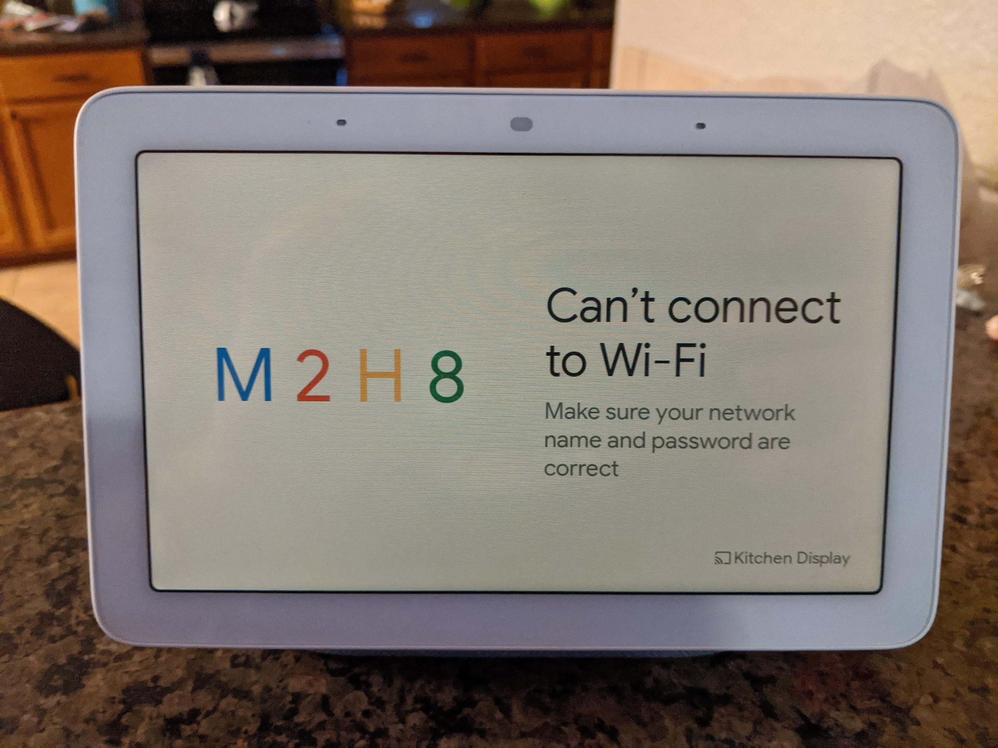
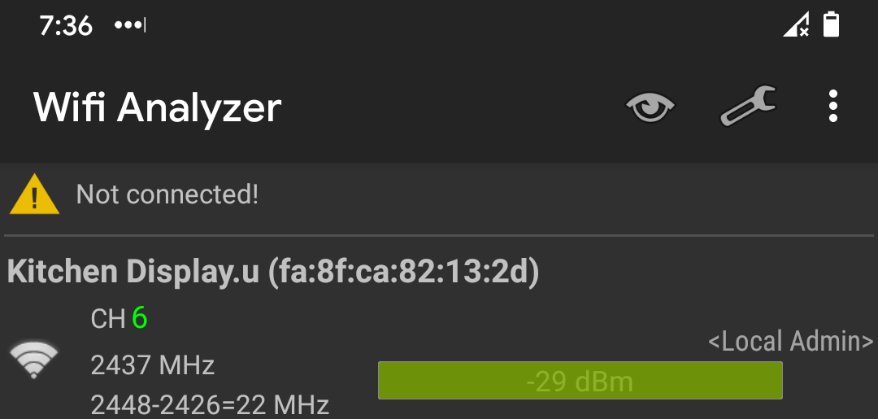
No Wi-Fi
This value seems to be static

Slide 5
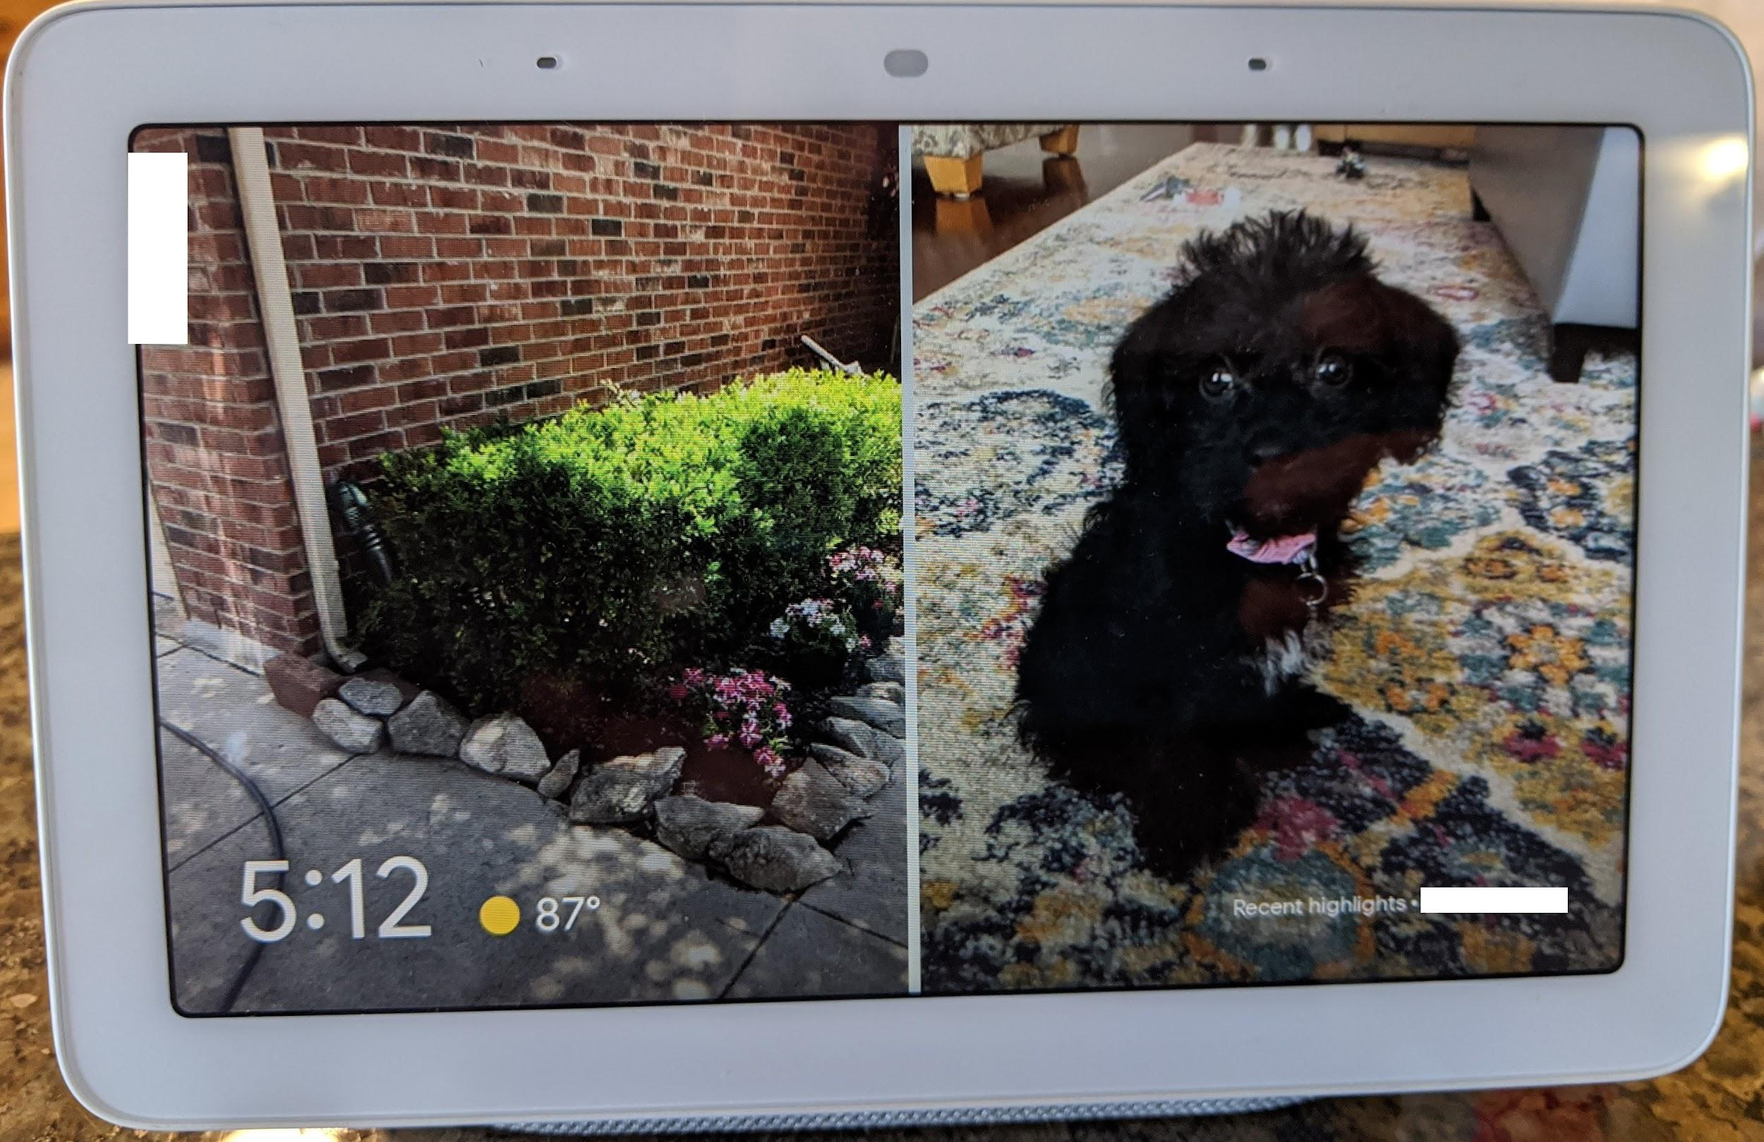
History of Google (aka Nest) Hub
Notes:
Model GA-00516-US (aka H1A)

Slide 6



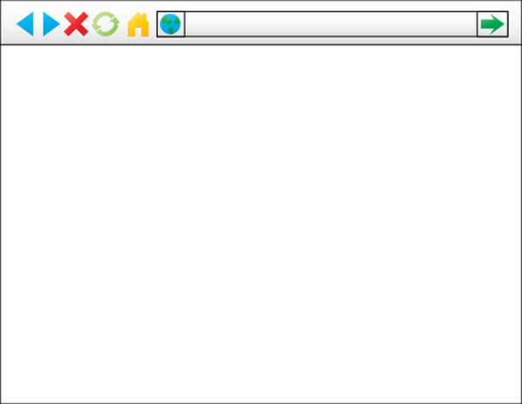


Previous Vulns
Smart Spies: Google Home Eavesdropping
https://www.youtube.com/watch?v=X2gddqD1wUI&feature=youtu.be https://srlabs.de/bites/smart-spies/
Researchers hack Siri, Alexa, and Google Home by shining lasers at them https://arstechnica.com/information-technology/2019/11/researchers-hack-siri-alexa-and-google-home-by-shining-lasers-at-them/
DEF CON 2019: Researchers Demo Hacking Google Home for RCE https://www.defcon.org/html/defcon-27/dc-27-speakers.html#Qian
Google Questions Assertion That Google Home Hub Is Vulnerable To Remote Hacking https://hothardware.com/news/google-home-hub-insecure
The APIs mentioned in this claim are used by mobile apps to configure the device and are only accessible when those apps and the Google Home device are on the same Wi-Fi network.” November 2018 Also: https://www.androidauthority.com/google-home-hub-security-920291/
Phishing
Notes:
https://www.engadget.com/2018-10-31-google-home-hub-api-security-flaw.html

Slide 7
Filters
Can we observe traffic to determine client is Google Home device?
MAC PREFIX (1C:F2:9A:37:0E:4B)
SSID FOR SETUP
Kitchen Display.u (different mac of fa:8f:ca:82:13:2d)
Assuming encrypted Wi-Fi so can’t see any IP traffic, just Wi-Fi packets
Do the Wi-Fi packets give away any patterns?

Slide 8
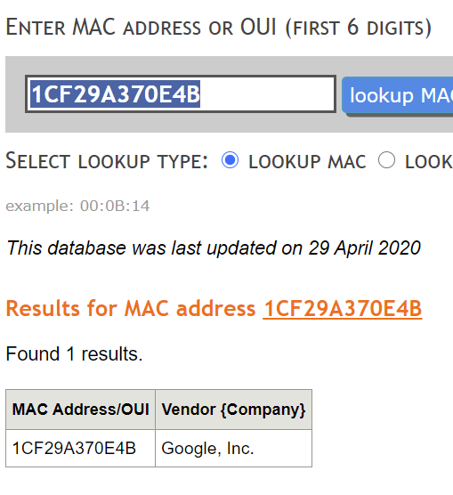
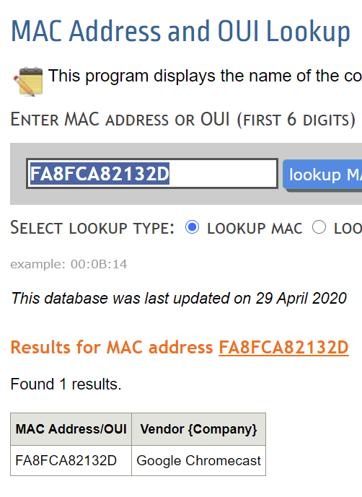

Slide 9
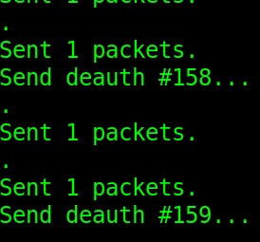
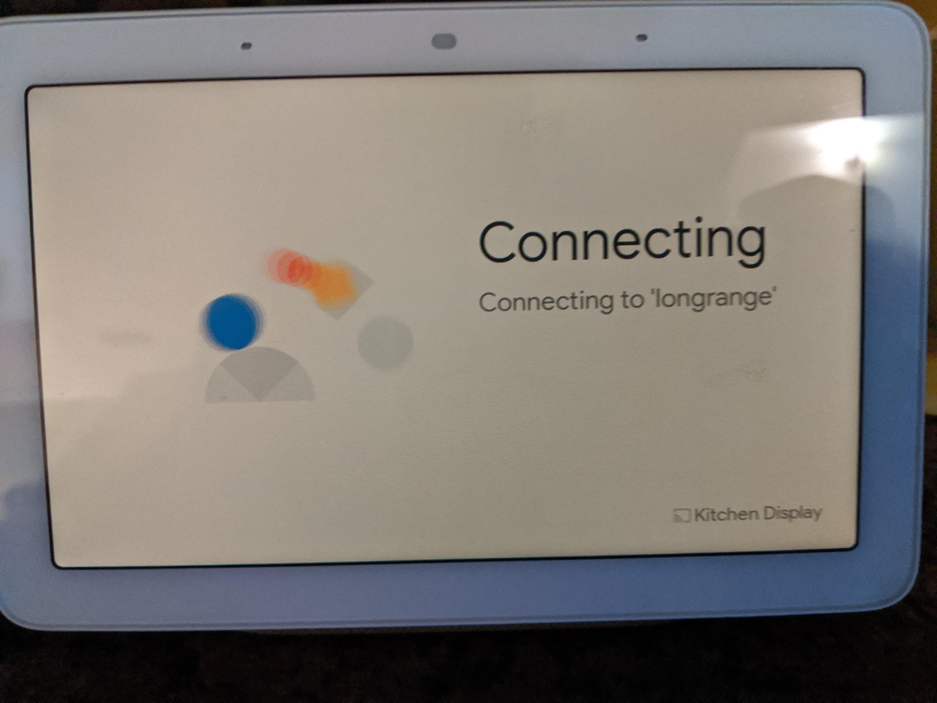
DeAuth a device

Slide 10
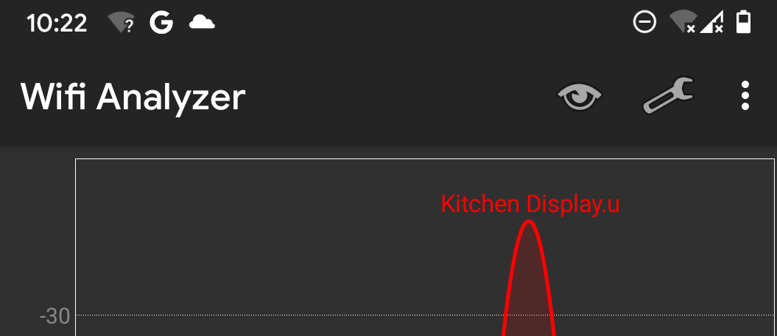
Screenshot from Wi-Fi scanner

Slide 11
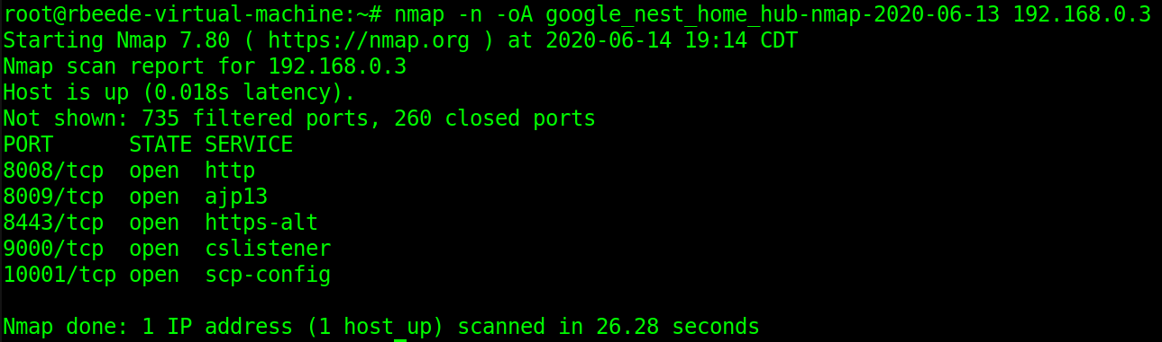
Got a Wi-Fi network, Now what?
What services are available in this mode?
nmap of normal operation (pre-deauth)

Slide 12
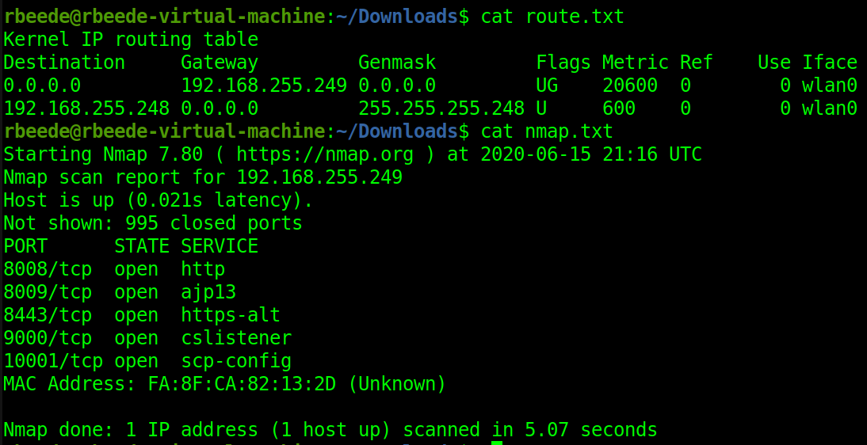
nmap of provision Wi-Fi network

Slide 13
Interesting Observation
After running deauths for 1 hour the Google Home gave up on the legit Wi-Fi.
Stopped running deauths
Unplugged power
Device Rebooted
Google Home wanted the mobile app to connect
Refused legit Wi-Fi network even though it was there

Slide 14
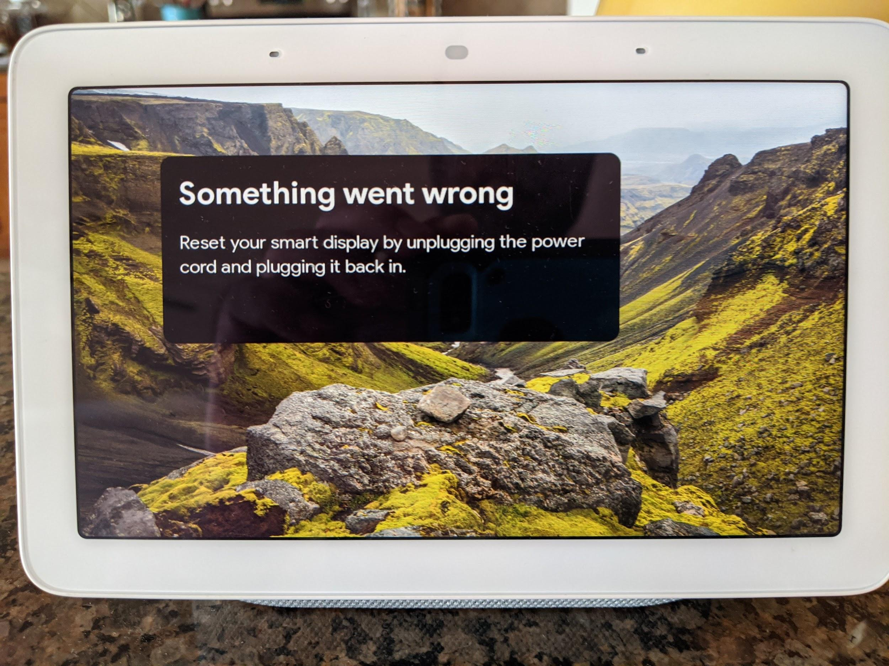
Still broadcasting Kitchen Display.u network

Slide 15
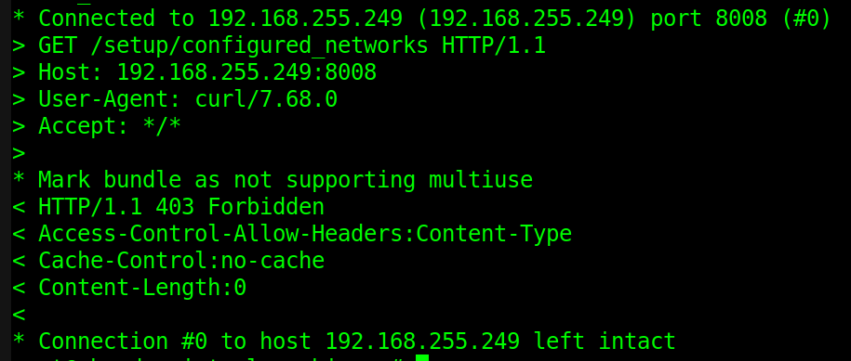
First access 403 Forbidden
https://www.androidpolice.com/2018/01/16/google-home-hidden-api-local-devices-can-use/

Slide 16
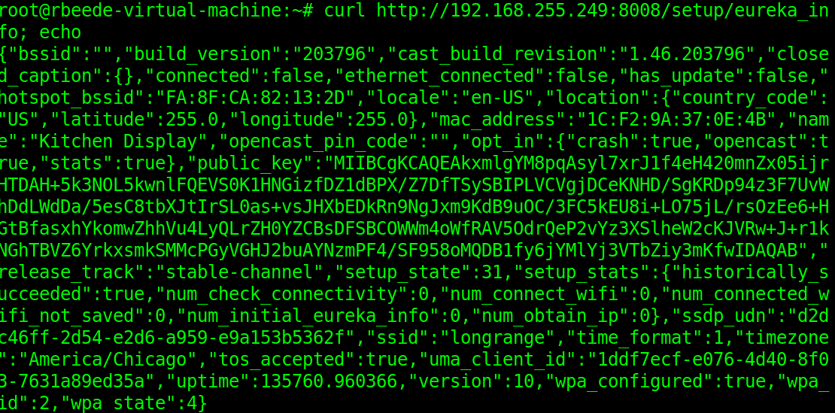
Thank you API reverse engineers!
CREDIT https://rithvikvibhu.github.io/GHLocalApi/

Slide 17
Current State
Hub will not connect to Internet
Without manual user intervention to fix
Broadcasting setup/provision wireless network SSID
Wants user to connect mobile app to fix Internet problem
Port 8008 is more locked down
June 2019 firmware update
Restricts unauth functionality
Before update could reboot, reset, etc. on device
Was pwnable

Slide 18
Video Demo
https://github.com/rbeede/BSidesSATX2020/tree/master/silent-demo-video
Shows tool being run
Result of device disconnecting
Attacker connecting to provision network and querying API

Slide 19
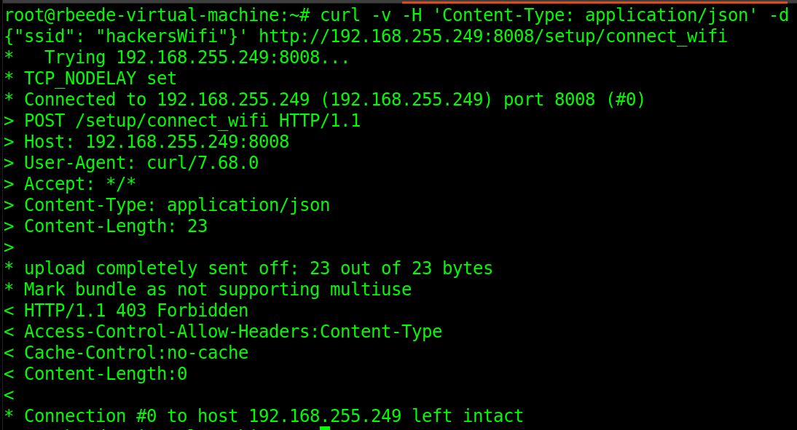
Denied easy network hijacking change

Slide 20
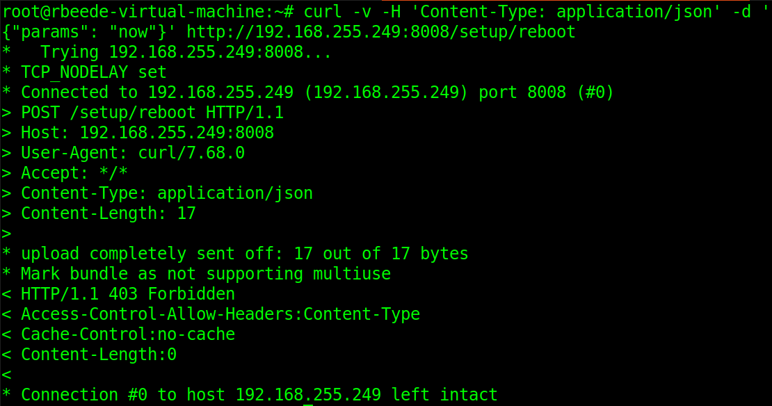
Can’t even reboot without some token

Slide 21
So Security Status
Hardening by Google
An already setup device requires a token from the mobile app
Prior
API was available over port 8008 with many functions
This is a good thing for IoT security!
Falling into a provision state to fix Wi-Fi is only safe if attacker can’t reset device to factory settings or mess with it too
What if the user lost their token (i.e. phone)
Physical access to reset device must be required for a factory reset

Slide 22
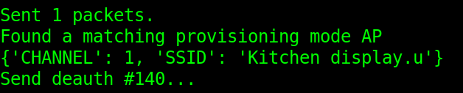
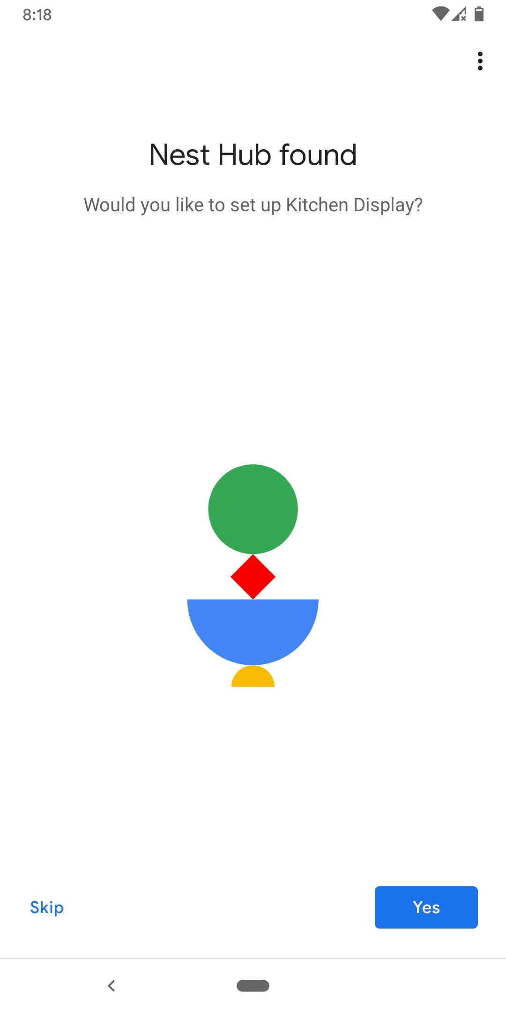
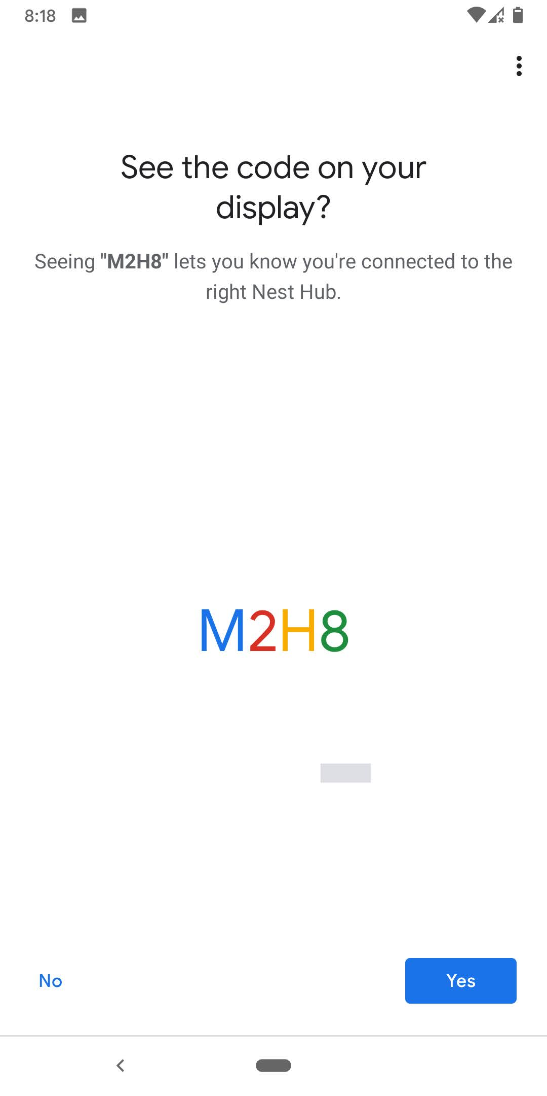
But is it really safe?
Remember that code?
Well even if attacker can’t see it just say YES
Notes:
From the attacker’s mobile device

Slide 23
Did you pwn it?
Found an attack surface
Attacker using “Home” app can start provision process
Used a different google account that is NOT the legit users
Device did accept using attacker’s Wi-Fi network
Since it could not connect to legit owner’s Wi-Fi anymore due to deauth
Meaning: I forced the device to connect to my Wi-Fi network with a different SSID
No evil twin required, able to precision target just the Home hub device
But Home hub kept legit owners account, photos, etc.
Kicked my attacker “Home” app out and did not use my evil Google account
Danger zone
Device is on Wi-Fi network controlled by attacker
Mitigating Control: the API (since June 2019) restricts calls
Only http://192.168.0.3:8008/setup/eureka_info is usable
Other APIs use TLS encrypted channels
But if future vuln/bug in API allows unauth attack?

Slide 24
Future Work
https://github.com/rithvikvibhu/GHLocalApi/issues/39
Can an attacker generate a token without user’s creds?
Not likely but script to create token with known creds exists
Any alternative ways to reset the device without the token?
Smarter device searching
Just a MAC prefix filter also matches Chromecast and other devices
Need better fingerprinting before the deauth
Perhaps profiles of the encrypted Wi-Fi traffic?
How does the app do this?
Does this work against other brands of smart home devices?
Do they protect the provisioning API better?
What about the 1st time provision out of the box
Automate race to grab the device first?
Update the scapy code to use two wireless devices
One for deauth, Other for provision network tampering
Do any third party connections/apps make insecure requests?

Slide 25
References
https://github.com/rbeede/BSidesSATX2020
https://docs.google.com/presentation/d/1TC-WErW9naXuXSyRaIBLUCJYGtm69KuRLapNtox71CE
Background photos care of
https://www.pxfuel.com/en/free-photo-epfpc
https://pixabay.com/vectors/attack-death-ray-evil-laser-menace-1294254/

